Slide 1
Name:- Yash Rajendra Gaikwad
Data Analytics Trainee
Project 5:- IMDB Movie Analysis.
Software Used:- Microsoft Excel.
Analysis done on following Points:-
A) Movie Genre Analysis:- Analyze the distribution of movie geners and their impact on the IMDB score.
Task:- Determine the most common geners of moviesin database.Then, for each gener, calculate descriptive statistics of the IMDB score.
B)Movie Duration Analysis:- Analyze the distribution of movie durations and its impact on IMDB score.
Task:- Analyse the distribution of movie durations and identify the relationship between duration and IMDB score.
C) Language Analysis:- Examine the distribution of movies based on their language.
Task:- Determine the most common language used in movies and analyze their impact on IMDB score.
D) Director Analysis:- Influence of directors on movie rating.
Task:- Identify thetop directors based on their Avg. IMDB score and analyze their contribution to the sucess of movie using percentile calculations.
E) Budget Analysis:- Explore the relationship between movie budget and their financial sucess.
Task:- Analyze the corelation between movie budgets and gross earning and identify the movies with highest profit margin.

Slide 2
Data Cleaning:-
To clean the dataset we will be first dropping the columns which have no use for the analysis.
Columns like ‘Color’, ‘director_facebook_likes’, ‘actor_3_facebook_likes, ‘actor_2_name’, ‘actor_1_facebook_likes’, ‘cast_total_facebook_likes, ‘actor_3_name’, ‘facenumber_in_posts’, ‘plot_keywords’, ‘movie_imdb_link’, ‘content_rating’ ,’actor_2_facebook_likes’, ‘aspect_ratio’, ‘movie_facebook_likes’ are the columns containing irrelevant data for the analysis tasks provided. So, these columns needs to be dropped.
After dropping the irrelevant columns now we need to remove the rows from the dataset having anyone of its column value as blank/NULL.
Then we need to get rid off the duplicate values in the dataset which can be achieved by using the ‘Remove Duplicate Values/Cells’ available in the ‘Data’ tab.
Now, all the data is cleaned and ready for analysis.

Slide 3
A) Movie Genre Analysis:- Analyze the distribution of movie geners and their impact on the IMDB score.
Task:- Determine the most common genres of moviesin database.Then, for each genre, calculate descriptive statistics of the IMDB score.
Process:-
Most of the movies contain more then one genre. so, use COUNTIF function to count the number of movies of each genre.
After that , we use Pie Chart to show the movies of specific genre.
For better clarification, we calculate the Median, Max, Min, Mode,Var and STDEV.
Lastly compare it with the IMDB score.
Result:-
As we can see in the below Action, Comedy, Drama, Adventure and crime are the most popular genres.
Top 20 movies according to IMDB score are mostly from Action,Drama, Crime Genres.

Slide 4
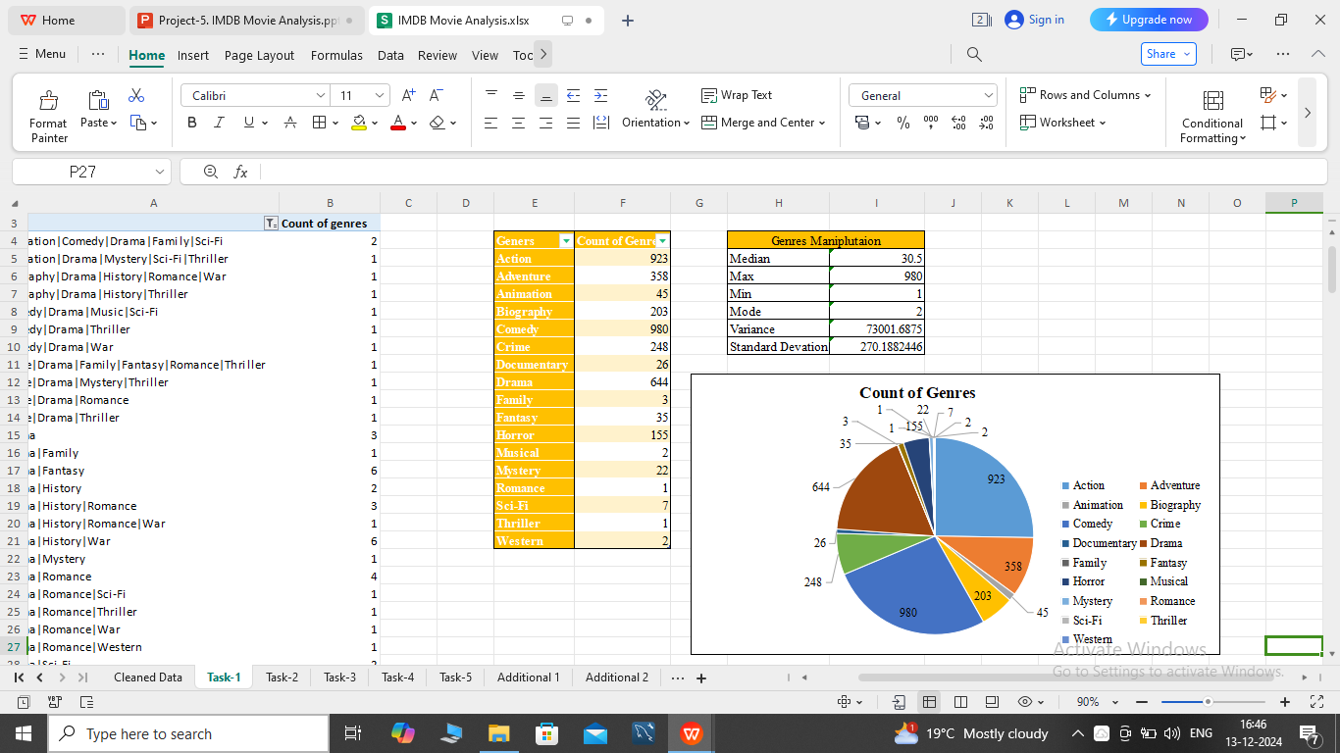
Result:-

Slide 5
B)Movie Duration Analysis:- Analyze the distribution of movie durations and its impact on IMDB score.
Task:- Analyse the distribution of movie durations and identify the relationship between duration and IMDB score.
Process:-
First we take the duration column and the imdb_score Column in seprate sheet so we can understand it very clearly and our task should look clean.
Then, we use the Scatter plot visualize the relationship between the movie duration and IMDB score.
Also , we add the trendline to assess the direction and strength of the relationship.
Lastly, we calculate the descriotive statistics such as Average, Median and Standard Deviation.
Result:-
In Scatter Plot we see that, most of the movies duration is between 75 - 175 min.
Most of the highest IMDB score movies duration is between 140 - 250 min.
Also most of the old movies have more movie duration then the new movies.

Slide 6
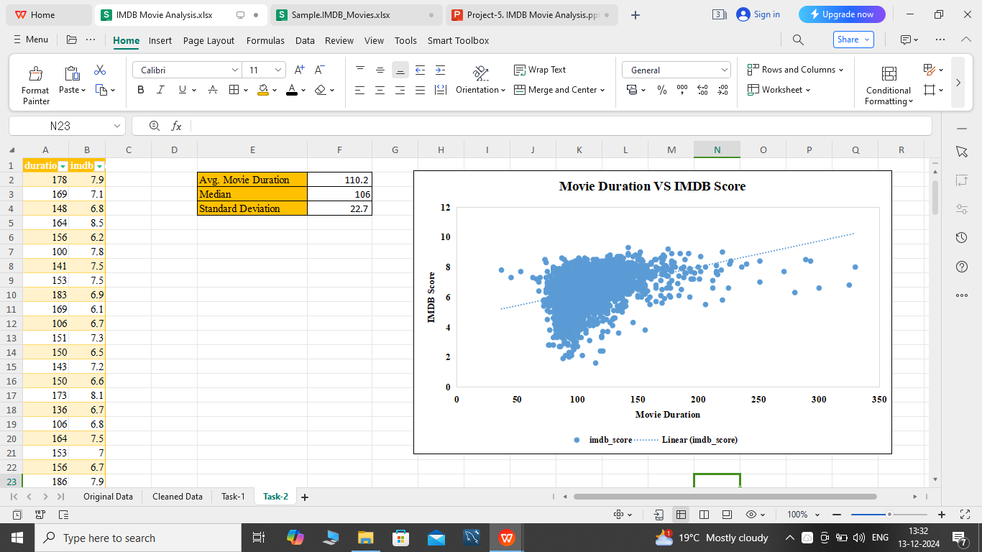
Result:-

Slide 7
C) Language Analysis:- Examine the distribution of movies based on their language.
Task:- Determine the most common language used in movies and analyze their impact on IMDB score.
Process:-
First we take the Movie Title, Language and IMDB score column on another sheet for better understanding.
We use the Pivot Table option by placing the Language comumn in to the row and Count of Language into the values.
We use the Pie Chart to visualize the movie language.
After that, we use this Pivot Table and the IMDB score data to calculate the Mean, Median and the Standard Deviation for the all language.
Result:-
Most of the movies are in English Language.
French and Spanish are the 2nd and 3rd languages used in movies.
All Top 20 IMDB score movies are English language movies.

Slide 8
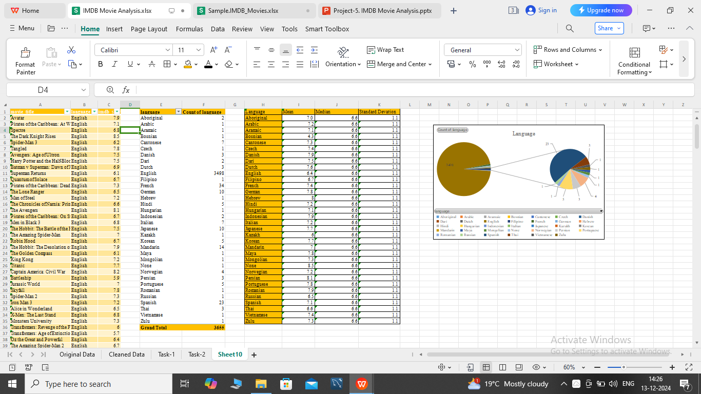
Pivot Table and Mean, Median, STDEV Tables:-

Slide 9
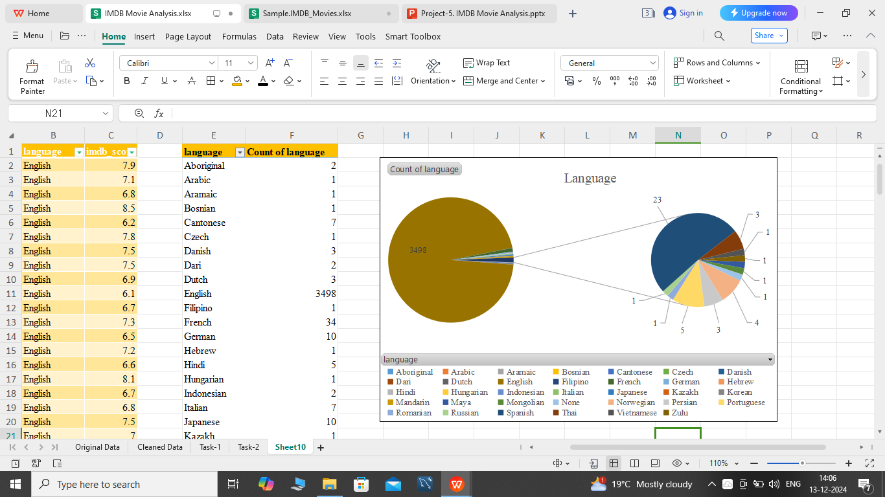
Result:-

Slide 10
D) Director Analysis:- Influence of directors on movie rating.
Task:- Identify thetop directors based on their Avg. IMDB score and analyze their contribution to the sucess of movie using percentile calculations.
Process:-
It is very simple, first take the Director name and IMDB score column and use the Pivot Table option.
We put the Director name in Row, IMDB score in filler and again IMDB score in values we use the Avg. of IMDB score option.
We directly get the table. but we only use Top 10 Director for visualization.
Result:-
Frank Darabont have highest IMDB score followed by Francis Ford Coppola, Quentin tarantino, Christopher Nolan, Peter Jackson and David Fincher.
Frank Darabont have directed the highest IMDB scored movie i.e. The Shawshank Redemption.
Francis Ford Coppola’s The Godfather movie series have 9 and 9.2 IMDB score.

Slide 11
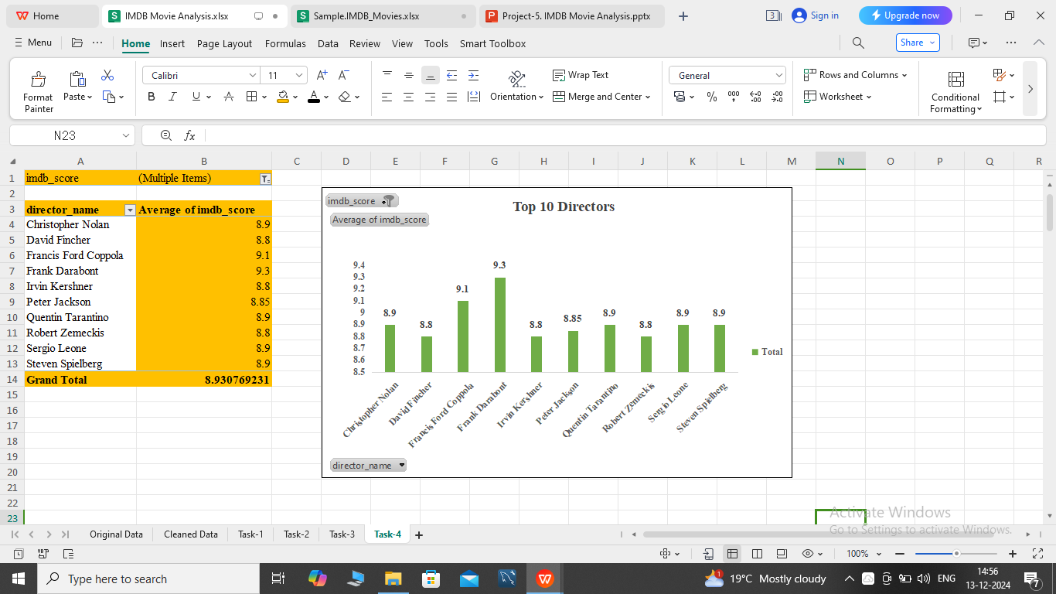
Result:-

Slide 12
E) Budget Analysis:- Explore the relationship between movie budget and their financial sucess.
Task:- Analyze the corelation between movie budgets and gross earning and identify the movies with highest profit margin.
Process:-
First we select the Budget and Gross earning column on another sheet to make it more simple.
We minus the Budget from the Gross earning to get the Profit for each movie.
After that, we use this Budget column and Profit column for visulization.
It will be more suitable to use the Scatter plot for this task.
Also we calculate the Maximum amd Minimum Profit by using he Max and Min function.
Result:-
Avatar is the most Profitable movie of all time followed by Jurasic World and Titanic.
Paranormal Activity is the most Profitable low budget movie of all time.
The Host is the least profitable movie.

Slide 13
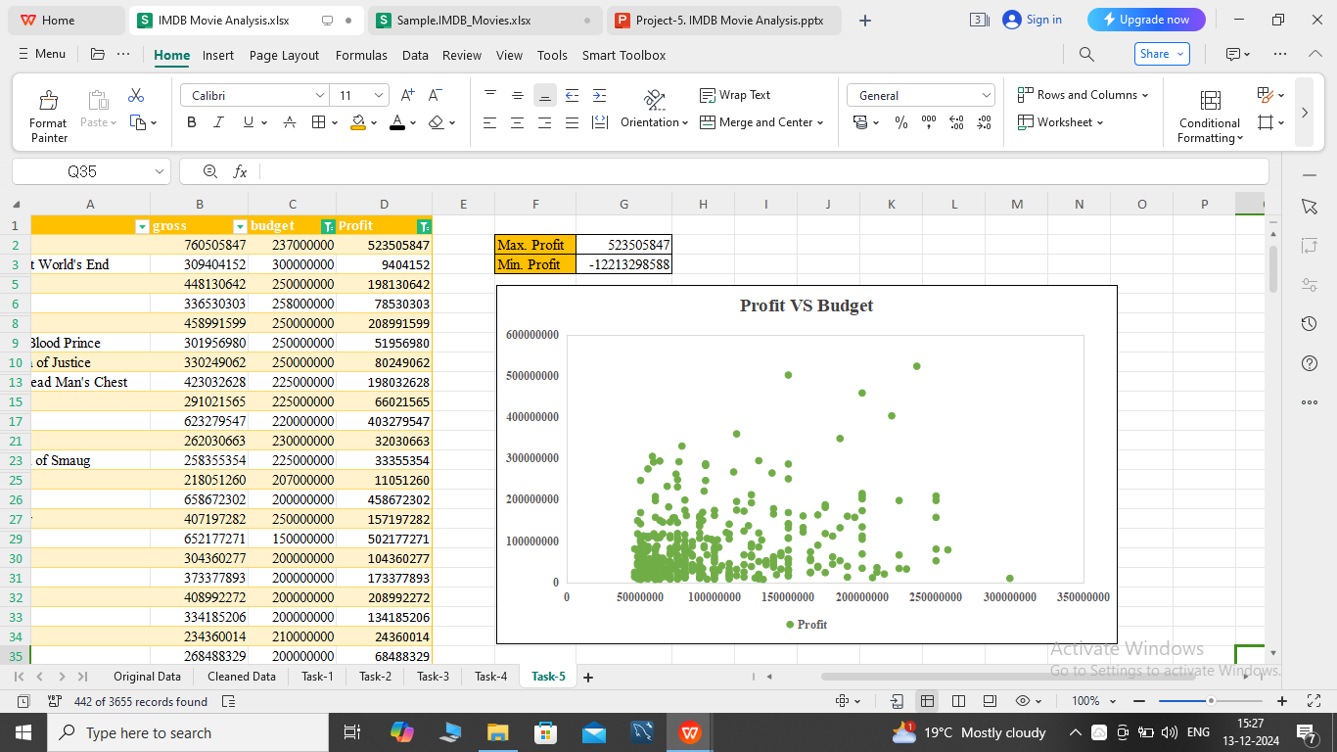
Result:-

Slide 14
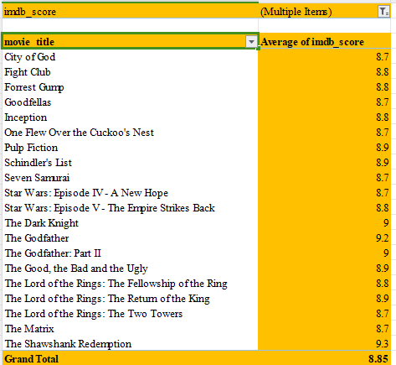
Additional Insight 1 :- Top 20 IMDB Scored Movies.
Result:- 1) The Shawshank Redemption movie have highest IMDB score.
2) The Lord of the Rings and Godfather is the highest IMDB Score Movie Series.

Slide 15
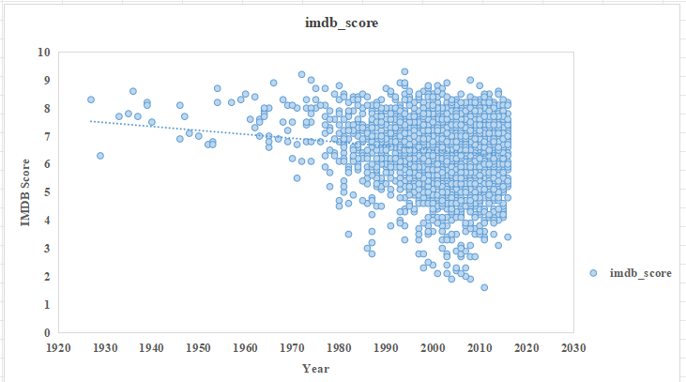
Additional Insight 2 :- IMDB Score VS Movie Release Year
Result :- 1) Most of the Old movies have high IMDB rating.
2) IMDB rating is declining as years passes.

Slide 16
END

